Slide 1
DAA432C
ASSIGNMENT 06
Presented by
-Anirudh Gupta (IIT2019228)
-Navneet Bhole (IIT2019229)
-Eshan Vaid (IIT2019230)

Slide 2
CONTENTS
Problem Statement
Algorithm
Algorithm Implementation
Time Complexity Analysis
Space Complexity Analysis
Time Complexity Graph
Space Complexity Graph
Results

Slide 3
PROBLEM STATEMENT
Optimal Job scheduling. Given N jobs where every job is represented by following three elements of it.
Start Time, Finish Time, Profit Associated.

Slide 4
DYNAMIC PROGRAMMING
Dynamic programming amounts to breaking down an optimization problem into simpler sub-problems, and storing the solution to each sub-problem so that each sub-problem is only solved once.
The core idea of Dynamic Programming is to avoid repeated work by remembering partial results and this concept finds it application in a lot of real life situations.
This problem has both properties of Dynamic Programming, Optimal Substructure and Overlapping Subproblems. Like other Dynamic Programming Problems, we can solve this problem by making a table that stores solution of subproblems.

Slide 5
ALGORITHM IMPLEMENTATION
The Algorithm is implemented as follows:
Firstly Sort the jobs by non-decreasing finish times.
Then for each i from 1 to n, determine the maximum value of the schedule from the subsequence of jobs[0..i]. Do this by comparing the inclusion of job[i] to the schedule to the exclusion of job[i] to the schedule, and then taking the max.
To find the profit with inclusion of job[i]. we need to find the latest job that doesn’t conflict with job[i]. The idea is to use Binary Search to find the latest non-conflicting job.

Slide 6
TIME COMPLEXITY ANALYSIS
Time Complexity:
Time complexity is the number of operations an algorithm performs to complete its task (considering that each operation takes the same amount of time). The algorithm that performs the task in the smallest number of operations is considered the most efficient one in terms of the time complexity.
The sorting algorithm will take O(N*logN) time and also when we are iterating each element to find the maximum profit till each job and then using Binary Search based function to find the latest job (before current job) that doesn’t conflict with current job which also takes O(N*logN) time so the overall time complexity is O(N*logN).

Slide 7
SPACE COMPLEXITY ANALYSIS
Space Complexity:
The space complexity of an algorithm is the amount of memory space required to solve an instance of the computational problem as a function of characteristics of the input. It is the memory required by an algorithm until it executes completely.
Since we are using a dp array to store the output for every overlapping subproblem i.e dp[i], The space complexity will be O(N).

Slide 8
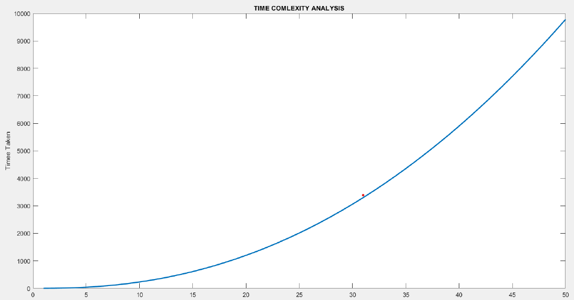
TIME COMPLEXITY GRAPH

Slide 9
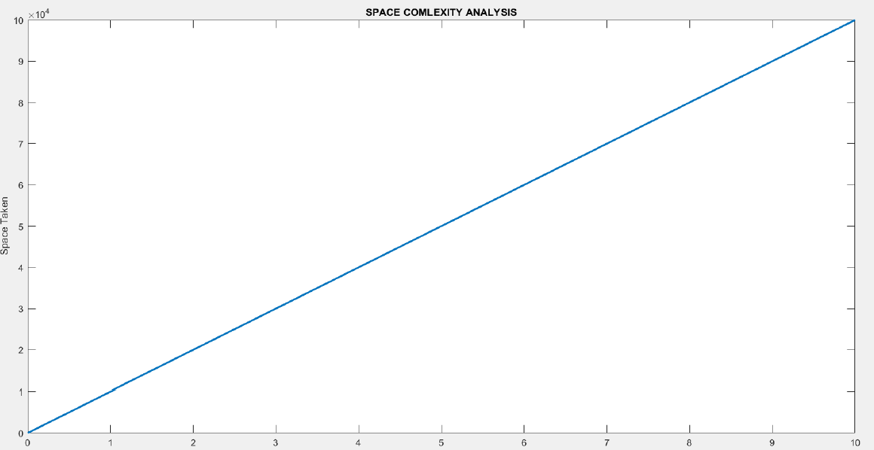
SPACE COMPLEXITY GRAPH

Slide 10
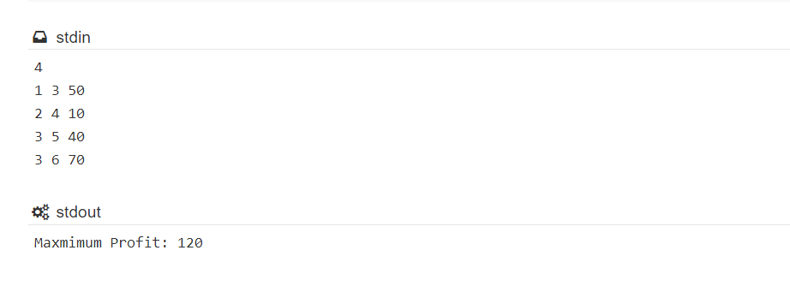
RESULTS

Slide 11
THANK YOU

